Slide 1
Employee Data Analysis using Excel
STUDENT NAME:THRUSHNA.P.B
REGISTER NO:422200926
DEPARTMENT:III B.COM ISM
COLLEGE:SHRI KRISHNASWAMY COLLEGE FOR WOMEN

Slide 2
PROJECT TITLE
VISUALIZING EMPLOYEE ATTENDANCE TRENDS WITH EXCEL CHARTS

Slide 3


AGENDA
Problem Statement
Project Overview
End Users
Our Solution and Proposition
Dataset Description
Modelling Approach
Results and Discussion
Conclusion
3/21/2024 Annual Review

Slide 4

PROBLEM STATEMENT
Currently, the organization tracks employee attendance through raw data entries in Excel spreadsheets. This data includes employee names, dates of attendance, and reasons for absence. However, this format makes it difficult to quickly identify trends, patterns, and anomalies. Management requires a more intuitive and visual representation of the attendance data to:
Identify Trends: Detect patterns in attendance over various periods (e.g., weekly, monthly, yearly) and understand peak periods of absenteeism.
Compare Attendance: Evaluate attendance trends across different departments or teams to identify discrepancies and areas needing attention.
Assess Impact: Analyze how attendance patterns correlate with other factors such as seasonal variations, holidays, or specific events.
Improve Decision-Making: Utilize visual insights to make data-driven decisions regarding staffing, resource allocation, and employee engagement strategies.

Slide 5

PROJECT OVERVIEW
Project Title: Enhancing Employee Attendance Tracking through Excel Data Visualization
Project Summary: This project aims to develop a comprehensive system for visualizing employee attendance data using Excel charts. The goal is to transform raw attendance data into actionable insights through various charting techniques, enabling management to identify trends, compare departmental performance, and make informed decisions to enhance workforce management.
Objectives:
Data Transformation:
Organize and structure employee attendance data in Excel to facilitate effective visualization.
Ensure data accuracy and consistency for reliable charting.

Slide 6

WHO ARE THE END USERS?
Key Considerations for End Users:
Ease of Use: Ensure that charts are user-friendly and accessible, with clear labels and legends.
Relevance: Tailor visualizations to the specific needs and concerns of each user group.
Interactivity: Provide interactive features where appropriate, allowing users to drill down into data specific to their needs.

Slide 7

OUR SOLUTION AND ITS VALUE PROPOSITION
Structured Data Entry: Clean and organize employee attendance data into a structured format, including fields such as Employee ID/Name, Date, Attendance Status, and Reason for Absence.
Data Integrity: Implement checks to ensure accuracy and consistency in the data

Slide 8
Dataset Description
Employee Information:
Employee ID: A unique identifier for each employee (e.g., EMP001, EMP002).
Employee Name: Full name of the employee (e.g., John Doe, Jane Smith).
Department: The department or team to which the employee belongs (e.g., Sales, HR, IT).
Attendance Records:
Date: The specific date of the attendance record (e.g., 2024-01-15).
Attendance Status: Indicates whether the employee was present or absent (e.g., Present, Absent, Late).
Reason for Absence: Details the reason for absence if applicable (e.g., Sick Leave, Personal Leave, Vacation).
Additional Information:
Shift/Work Hours: The shift or work hours for the employee, if

Slide 9

THE "WOW" IN OUR SOLUTION
The "WOW" factor in our solution lies in its ability to transform complex attendance data into intuitive, interactive, and visually compelling insights. By combining advanced charting techniques, real-time updates, and customizable features with a user-friendly design, we deliver a solution that not only meets the analytical needs of the organization but also enhances the overall experience of data exploration and decision-making.
3/21/2024 Annual Review
9

Slide 10
MODELLING
Modeling in the context of visualizing employee attendance trends with Excel charts involves creating a structured approach to prepare, analyze, and present attendance data effectively. This process ensures that the data is accurately represented and provides meaningful insights through various Excel charting techniques. Table Structure: Organize data into a structured table with clearly defined columns. Common columns include:Employee ID
Employee Name
Department
Date
Attendance Status
Reason for Absence
Shift/Work Hours
Attendance Type
Date Formatting: Ensure date columns are formatted consistently (e.g., YYYY-MM-DD).
10

Slide 11
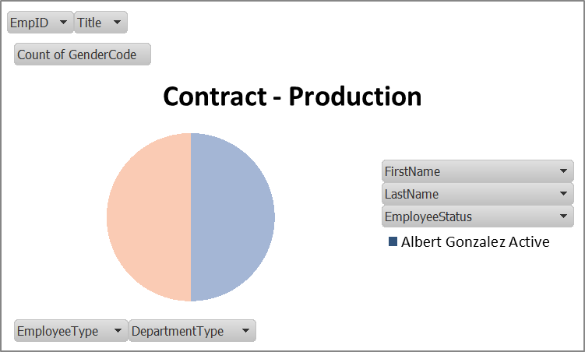
RESULTS
.
11

Slide 12
conclusion
Visualizing employee attendance trends with Excel charts transforms raw data into valuable insights, facilitating enhanced clarity, improved decision-making, and increased efficiency. By leveraging interactive and customizable charts, organizations can better understand attendance patterns, address issues proactively, and make data-driven decisions that drive organizational success.

